Slide 1



WEB TECHNOLOGIES
React JS –
Component States and LifeCycle Methods
Prof. Vinay Joshi and Prof. Sindhu R Pai
Department of Computer Science and Engineering

Slide 2

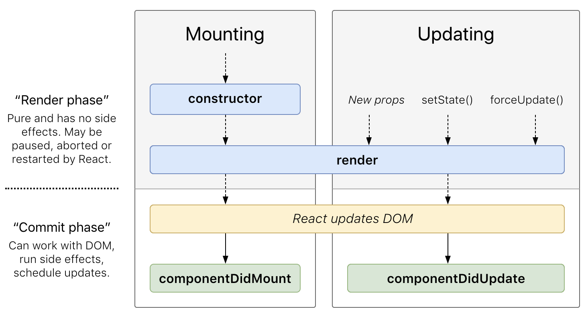
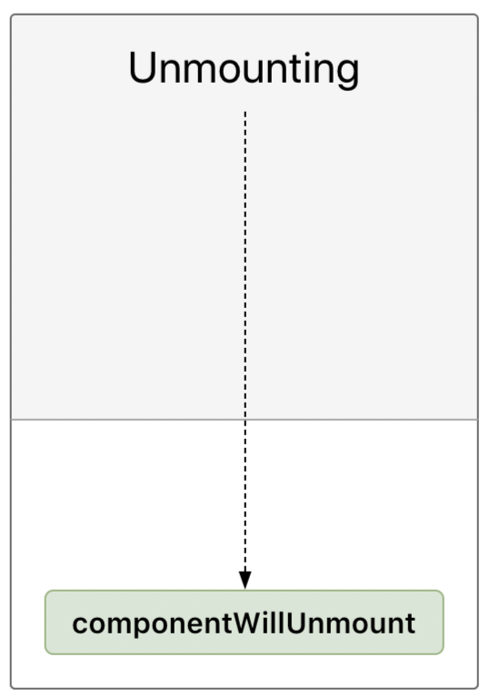
Component States and LifeCycle methods
Introduction to Life Cycle
The series of events that happen from the starting of a React component to its ending.
Every component in React should go through the following lifecycle of events.
Mounting - Birth of the Component
Updating- Growing of component
Unmounting- End of the component

Slide 3
Component States and LifeCycle methods
Methods
componentWillMount()
Executed before rendering, on both the server and the client side
constructor()
Called before the component is mounted.
Implementation requires calling of super(props) before further moving. Otherwise, this.props it will be undefined in the constructor, which can lead to a major error in the application.
Supports Initializing the state and Binding our component
render()
Most useful life cycle method as it is the only method that is required
Handles the rendering of component while accessing this.state and this.props

Slide 4

Component States and LifeCycle Methods
Component States
The example below starts with the favorite color being "red", but the getDerivedStateFromProps() method updates the favorite color based on the favcol attribute:
class Header extends React.Component {
constructor(props) {
super(props);
this.state = {favoritecolor: "red"};
}
static getDerivedStateFromProps(props, state) {
return {favoritecolor: props.favcol };
}
render() {
return (
<h1>My Favorite Color is {this.state.favoritecolor}</h1>
);
}
}
ReactDOM.render(<Header favcol="yellow"/>, document.getElementById('root'));

Slide 5
Component States and LifeCycle Methods
Component States
componentDidMount
The componentDidMount() method is called after the component is rendered.
This is where you run statements that requires that the component is already placed in the DOM.
class Header extends React.Component {
constructor(props) {
super(props);
this.state = {favoritecolor: "red"};
}
componentDidMount() {
setTimeout(() => {
this.setState({favoritecolor: "yellow"})
}, 1000)
}
render() {
return (
<h1>My Favorite Color is {this.state.favoritecolor}</h1>
);
}
}
ReactDOM.render(<Header />, document.getElementById('root'));

Slide 6
Component States and LifeCycle methods
Demo of diff lifecycle methods
Updating
The next phase in the lifecycle is when a component is updated.
A component is updated whenever there is a change in the component's state or props.
React has five built-in methods that gets called, in this order, when a component is updated:
getDerivedStateFromProps()
shouldComponentUpdate()
render()
getSnapshotBeforeUpdate()
componentDidUpdate()
The render() method is required and will always be called, the others are optional and will be called if you define them.

Slide 7
Component States and LifeCycle methods
Demo of diff lifecycle methods
shouldComponentUpdate
In the shouldComponentUpdate() method you can return a Boolean value that specifies whether React should continue with the rendering or not.
The default value is true.
The example below shows what happens when the shouldComponentUpdate() method returns false:

Slide 8
Component States and LifeCycle methods
Demo of diff lifecycle methods
class Header extends React.Component {
constructor(props) {
super(props);
this.state = {favoritecolor: "red"};
}
shouldComponentUpdate() {
return false;
}
changeColor = () => {
this.setState({favoritecolor: "blue"});
}
render() {
return (
<div>
<h1>My Favorite Color is {this.state.favoritecolor}</h1>
<button type="button" onClick={this.changeColor}>Change color</button>
</div>
);
}
}

Slide 9
Component States and LifeCycle methods
Demo of diff lifecycle methods
getSnapshotBeforeUpdate
In the getSnapshotBeforeUpdate() method you have access to the props and state before the update, meaning that even after the update, you can check what the values were before the update.
If the getSnapshotBeforeUpdate() method is present, you should also include the componentDidUpdate() method, otherwise you will get an error.

Slide 10
Component States and LifeCycle methods
Demo of diff lifecycle methods
componentDidUpdate
method that is executed after the React Component has been rendered (after an
update to the component using setState or new props added)

Slide 11
Component States and LifeCycle methods
Demo of diff lifecycle methods
Unmounting
The next phase in the lifecycle is when a component is removed from the DOM, or unmounting as React likes to call it.
React has only one built-in method that gets called when a component is unmounted:
componentWillUnmount()

Slide 12
Component States and LifeCycle methods
Demo of diff lifecycle methods
componentWillUnmount
The componentWillUnmount method is called when the component is about to be removed from the DOM.

Slide 13
Lists in React
Lists
Lists are mainly used for displaying menus in a website, for example, the navbar menu. In regular JavaScript, we can use arrays for creating lists.
Let’s first see how we can traverse and update any list in regular JavaScript. We can use the map() function in JavaScript for traversing the lists.
The map() method creates a new array populated with the results of calling a provided function on every element in the calling array.
const array1 = [1, 4, 9, 16];
// pass a function to map
const map1 = array1.map(x => x * 2);
console.log(map1);
// expected output: Array [2, 8, 18, 32]

Slide 14
Lists in React
Lists
// Arrow function
map((element) => { /* ... */ })

Slide 15
Lists in React
Lists
Let us now create a list of elements in React.
We will render the list numbers in the above code as an unordered list element in the browser rather than simply logging in to the console.
To do this, we will traverse the list using the JavaScript map() function and updates elements to be enclosed between <li> </li> elements.
Finally we will wrap this new list within <ul> </ul> elements and render it to the DOM.

Slide 16
Lists in React
Lists
const numbers = [1,2,3,4,5];
const updatedNums = numbers.map((number)=>{
return <li>{number}</li>;
});
ReactDOM.render(
<ul>
{updatedNums}
</ul>,
document.getElementById('root')
);

Slide 17
Lists in React
Lists
function Navmenu(props)
{
const list = props.menuitems;
const updatedList = list.map((listItems)=>{
return <li>{listItems}</li>;
});
return(
<ul>{updatedList}</ul>
);
}
const menuItems = [1,2,3,4,5];
ReactDOM.render(
<Navmenu menuitems = {menuItems} />,
document.getElementById('root')
);

Slide 18
Lists in React
Lists

Slide 19
THANK YOU
Vinay Joshi and Sindhu R Pai
Department of Computer Science and Engineering
vinayj@pes.edu
+91 80 2672 6622
sindhurpai@pes.edu
+91 8277606459

